Slide 1
Introduction
Players Transfer Dataset
The following is a list of most expensive association football transfers, which details the highest transfer fees ever paid for players, as well as transfers which set new world transfer records.

Slide 2
The aim of the project
Analyzing players' data and knowing the highest market values for them

Slide 3
Problems in dataset
-Delete the column “unnamed”
- Outliers in column “ age”

Slide 4
Questions about players Transfer
-Q1: Who is the player with the highest market value in England?
-Q2: Who is the player with the highest market value in Brazil
-Q3: What is the name of the club with the most goals?
-Q4: Where is the position of the most scoring player in France?

Slide 5
Questions about players Transfer
-Q5: Where is Roberto Firmino position in Liverpool?
-Q6: Who is the player who has two red cards?
-Q7: Who is the player who has a high marketing value and sits on the bench ?
-Q8:Who is the most scoring player with a red card?

Slide 6
Questions about players Transfer
-Q9:How many matches did Vinícius Júnior play and how many goals did he score?
-Q10:Which club did Eden Hazard move to and how old is he?
-Q11:How many transfers does Atletico Madrid have?
-Q12:Who is the player who made the most assists at the age of 24?

Slide 7
Questions about players Transfer
-Q13: How many French players has he moved to Real Madrid Hotspur?
-Q14: To which club did the player Gavi move and how many times did he replaced
-Q15: What is the marketing value of the players of a player who moved to Real Madrid to play as a Right Winger?

Slide 8
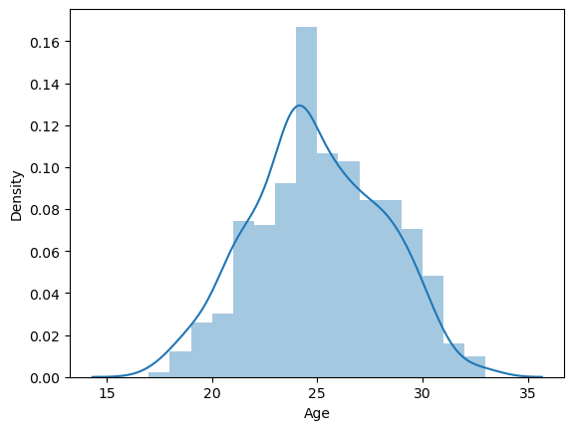
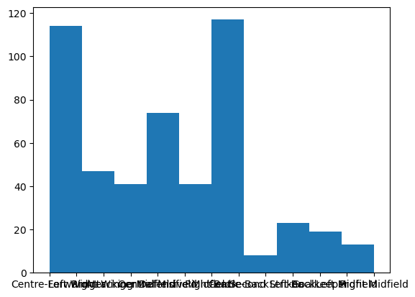
Visualization
distplot
histplot

Slide 9
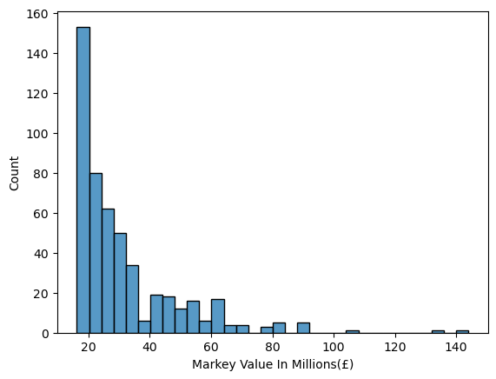
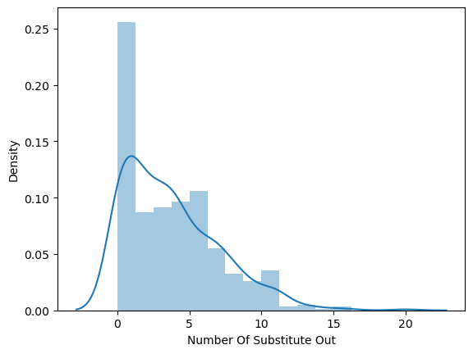
histplot
distplot

Slide 10
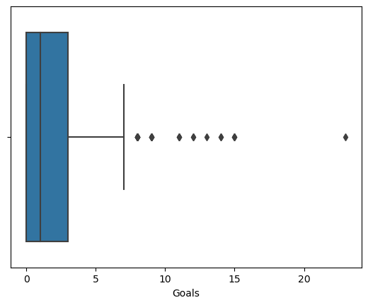
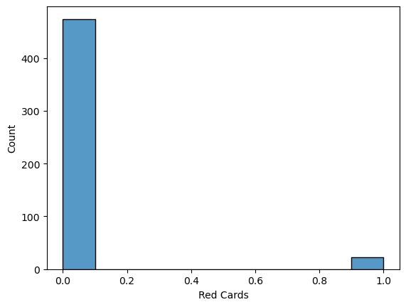
boxplot
histplot

Slide 11
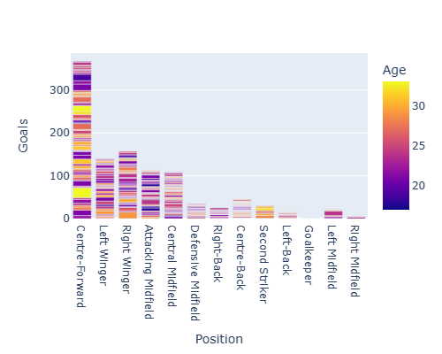
barplot

Slide 12
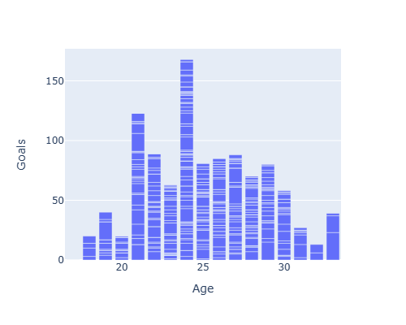
barplot

Slide 13
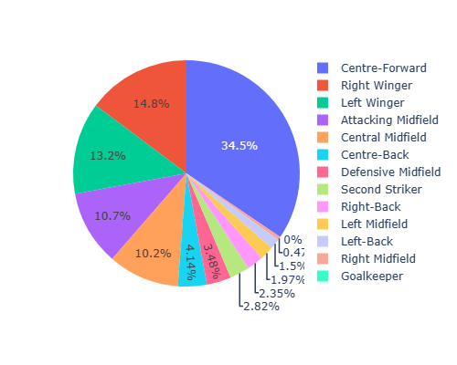
pieplot

Slide 14
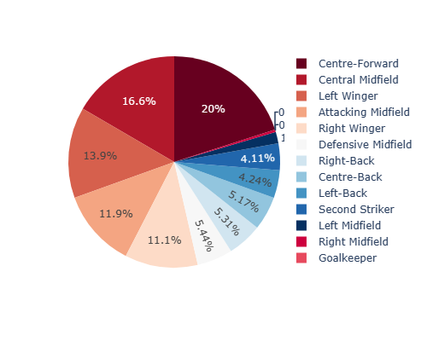
pieplot

Slide 15
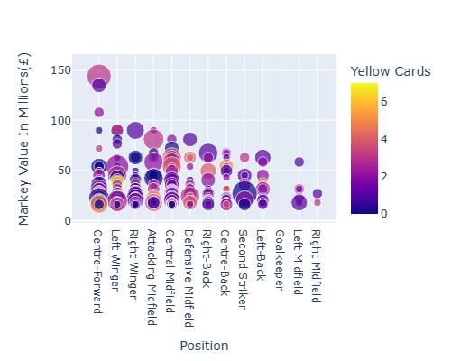
scatterplot

Slide 16
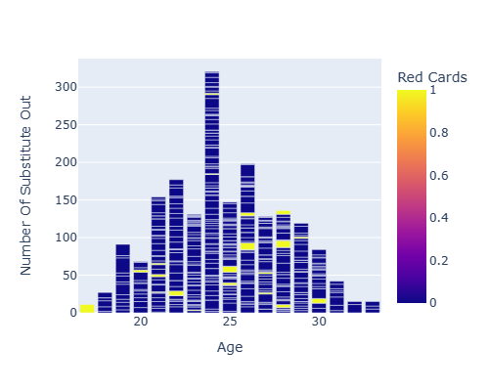
barplot

Slide 17
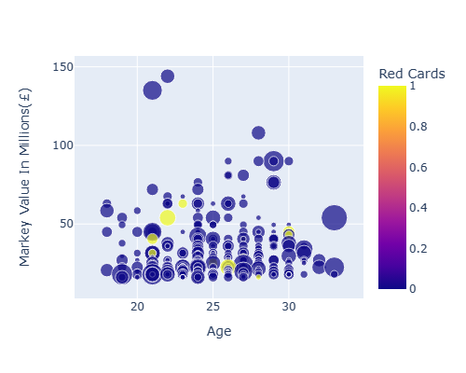
scatterplot

Slide 18
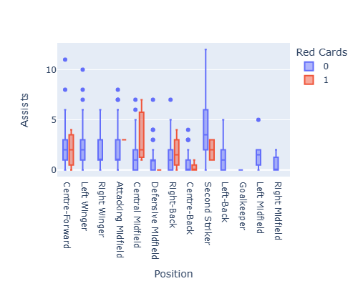
boxplot

